Slide 1
1.3 Segments, Rays, Lines and Planes

Slide 2
Parts of Lines
Segment
The part of a line consisting of two endpoints and all the points in between

Slide 3
Parts of Lines
Ray
The part of the line consisting of one endpoint and all the points of the line on one side of the endpoint

Slide 4
Parts of Lines
Opposite Rays
Two collinear rays with the same endpoint
Opposite rays always form a line!

Slide 5
Practice
Name the segments
Name the rays
Name a pair of opposite rays

Slide 6
Types of Lines
Intersecting
Same plane?
Intersect?

Slide 7
Types of Lines
Parallel
Same plane?
Intersect?

Slide 8
Types of Lines
Skew
Same plane?
Intersect?

Slide 9
Types of Lines
Skew lines are hard to see.
Activity Time!
Notes:
See directions for making model on lesson plan sheet.

Slide 10
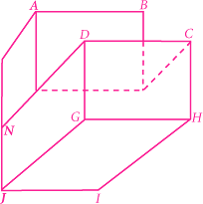
Example
Name all segments
that intersect
Name all segments that are parallel to
Name all segments that are skew to

Slide 11
Parallel Planes
Parallel planes are planes that do not intersect.
Name a plane that is parallel to plane ABCD.
Name another pair of parallel planes.

Slide 12
Practice
Are and
in the same plane?
2. Name all the segments parallel to .

Slide 13
Practice
Name all segments skew to
4. Draw on the diagram.

Slide 14
Practice
Mark a point I on the diagram so that
and are opposite rays.

Slide 15
Exit
Homework

